Slide 1
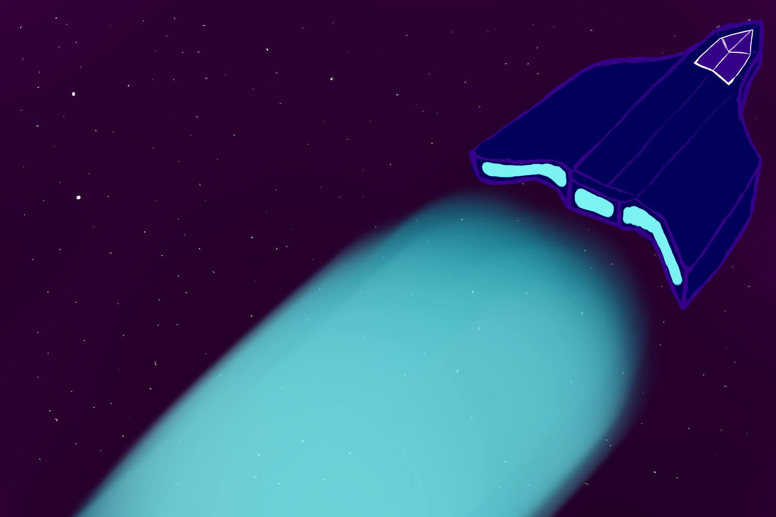
Group Work Coursework
Task of Choice – Space Game
Space Protocol By Nightmare Protocol
Project Manager – John Thorpe(40316673)
User Interface – Zyrynyl Melendres(40319172) & Alasdair Malcolm(40279979)
Object Designer – William Smallwood(40322938)
User Feature Analyst – Juan B. Navas(40324301)

Slide 2
List of Features
Go to Planets
Impulse (movement)
Impulse Backwards(movement)
Encounter Enemies/Allies
Fight
Trade

Slide 3
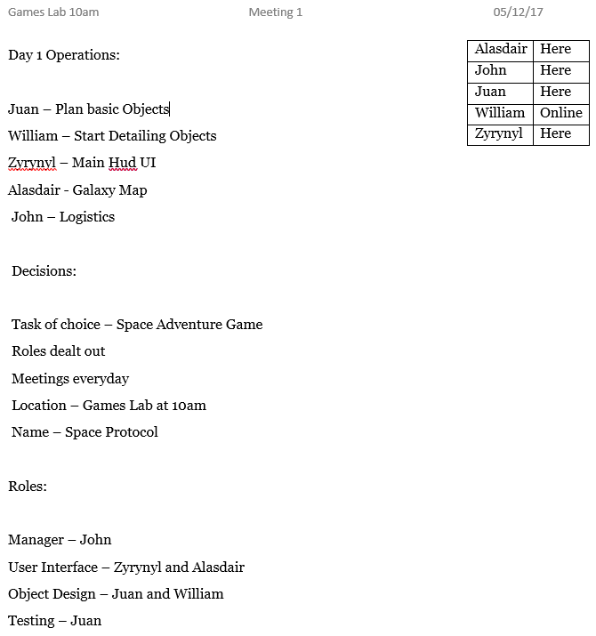
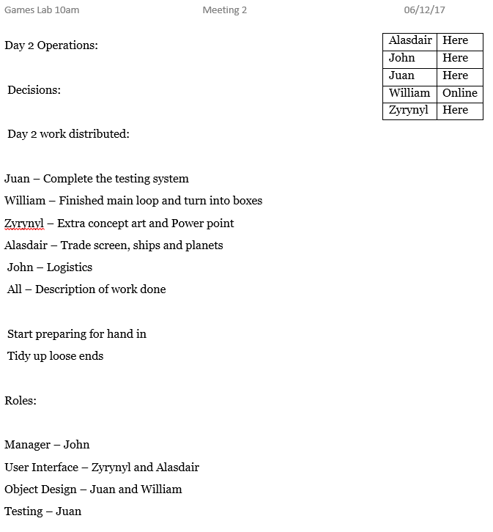
Project Management

Slide 4
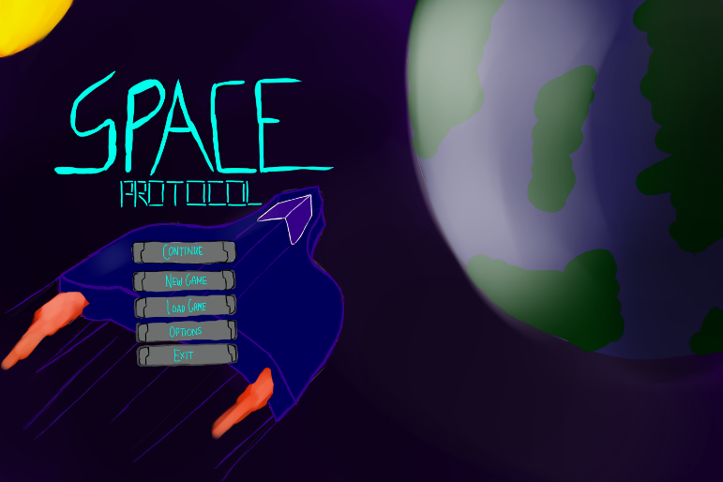
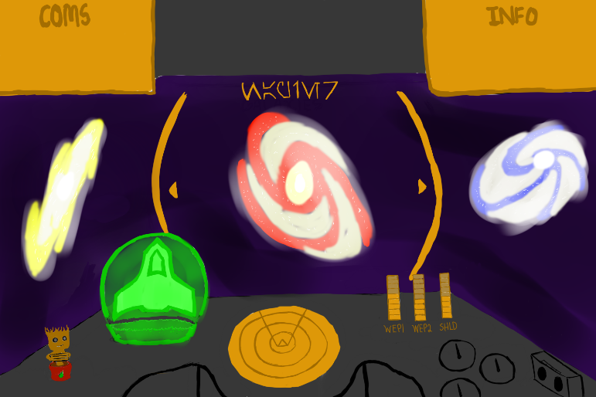
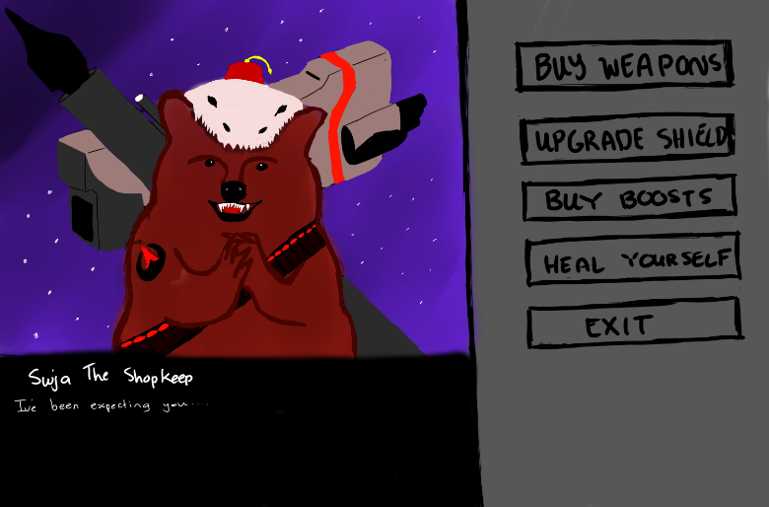
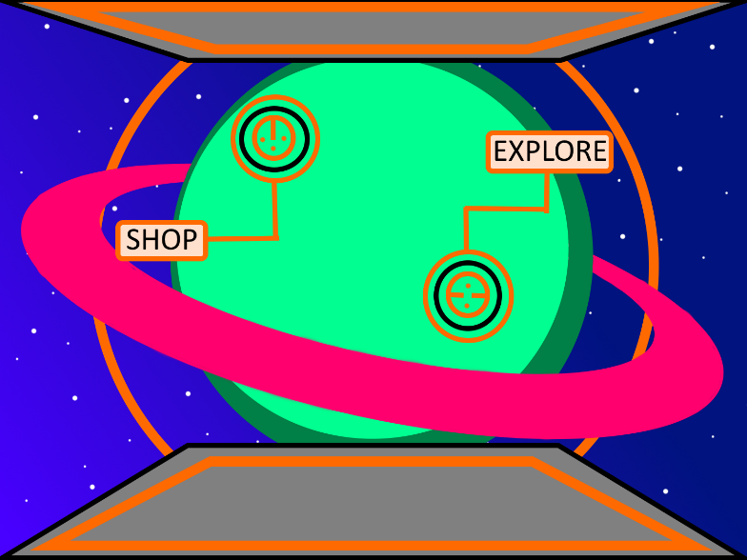
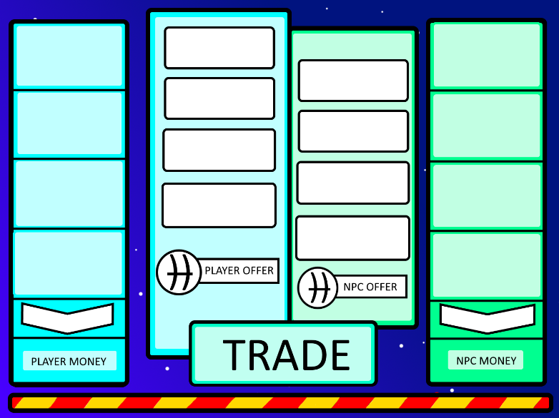
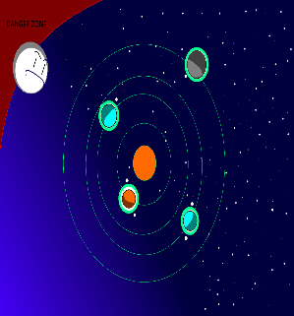
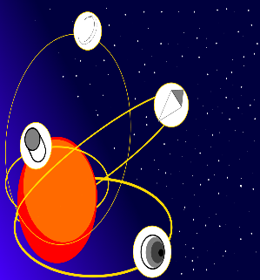
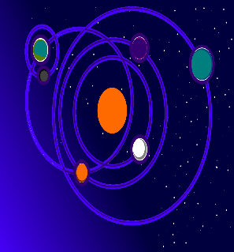
User Interface
Main Menu
Ship HUD
Shop UI
Planet UI
Trade UI
Solar System UI

Slide 5
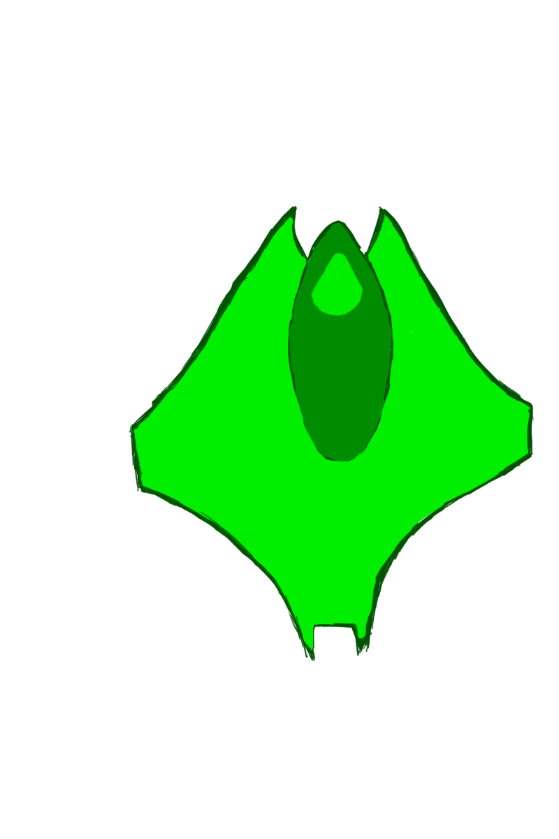

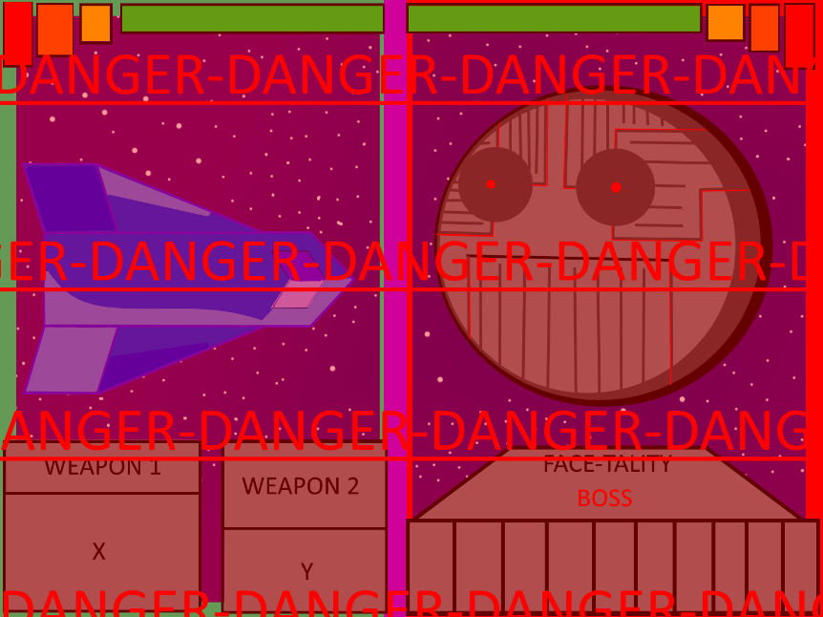

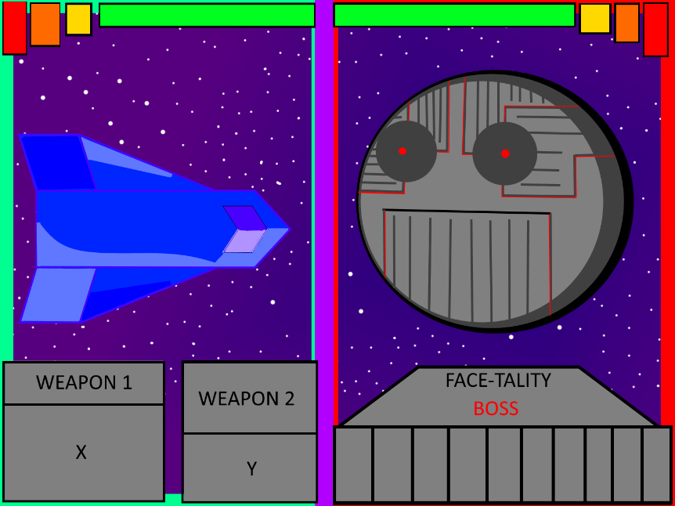
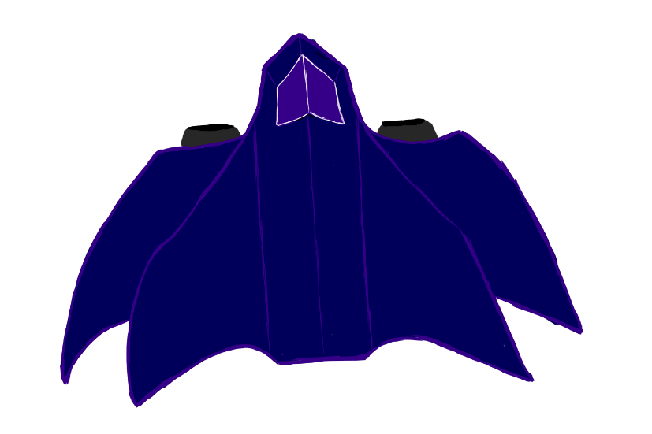
User Interface 2
Combat UI
Concept Arts
Enemy
Ally Ship
Upgraded Ship
Rare Enemy

Slide 6
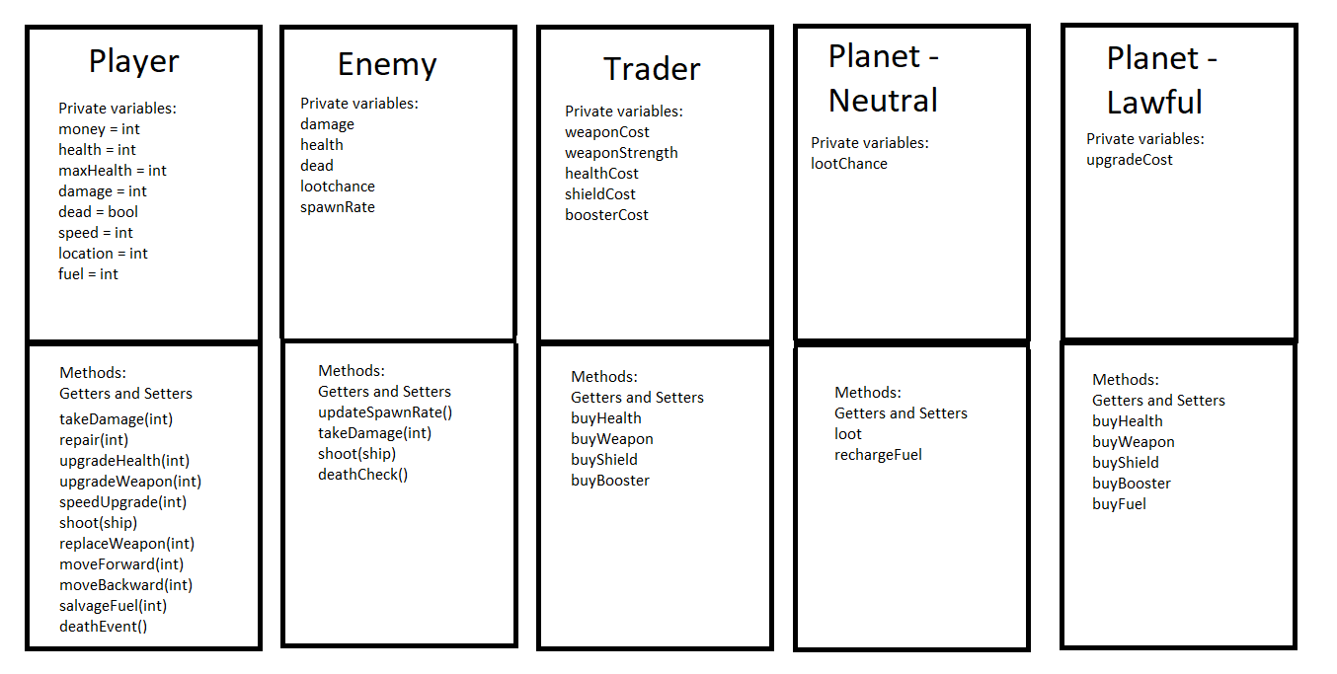
Object Orientation

Slide 7
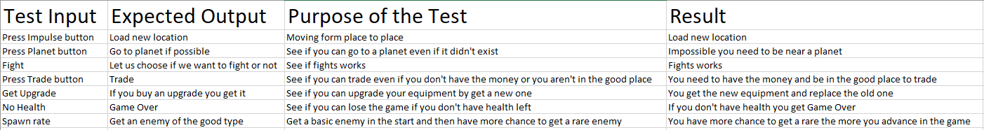
Black Box Test

